Slide 1


HOMETALK
ILAN DAHAN
SR. PRODUCT MANAGER & UX EXPERT

Slide 2

HOMETALK OVERVIEW

Slide 3

One liner
“ we are the world’s largest DIY community ”

Slide 4
Website
Community
10 M
Members
Traffic
40 M
Monthly visits
Engagement
300 M
Monthly page visits

Slide 5




Social
hometalk Facebook page
hometalk TV Facebook page
Followers
Followers
5.4 M
300 K
Users mention Facebook page
Users mention Facebook page
2.2 M
None
Video views up to
Video views up to
15 M
9 M
15 K
50 K
900 K

Slide 6
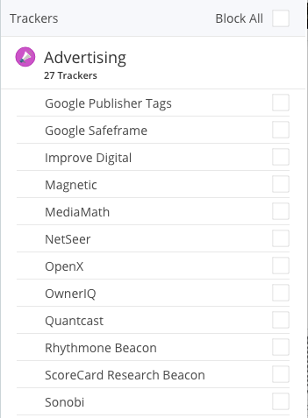
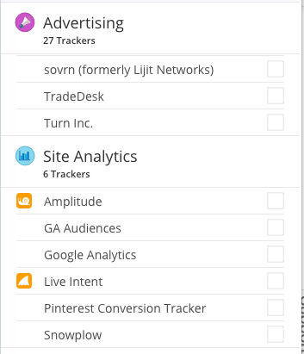
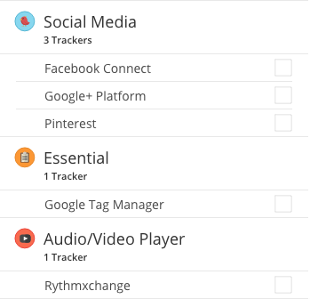
Data partitions
38 Trackers on post page
Loading time (avg):
Post page – 7.94 sec
Home page – 3.4 sec
03
01
06
27
social
essential
analytics
advertisement

Slide 7

HOMETALK DIGITAL
IDENTITY

Slide 8
hometalk is a ...
Social network
Forum
?
Blog
Portal

Slide 9
Social networking main features
Encouragement of engagement
Publish posts, pictures, videos
Follow other users
Wisdom of the crowds – ask questions
User profile
Trend
Young pepole
Content aggregator

Slide 10
Forum main features
Encouragement of engagement
Ability to follow users
Wisdom of the crowds – ask questions
Personal
Specific target audience
Rarely receives traffic from a massive audience
Content aggregator

Slide 11
Blog main features
Old fashion grid (3:2)
Maximum advertisment on the side column
The continuity of reading posts is caused by a side column
Small in size but uniqe content
Spesific content – only one specialty
Leaning on social networks to survive
Produces its own content

Slide 12
Portal main features
New content grid (5-6 columns)
Veriuse content
Topics are divided by the hierarchy (verticals & sub-verticals)
Massive traffic
Various e-mail marketing options
Generates massive traffic
Depending on the massive amount of quality content in order to be relevant
Produces some of his own content
Majority of the content is aggregated

Slide 13
So… hometalk must be...
Portal
Social
HOMETALK
Forum
Blog
A hybrid

Slide 14

THE SOLUTION

Slide 15
Formulation of digital identity
My main experience, look & feel
10%
90%
10 20 30 40 50 60 70 80 90 100
Blog, social, forum
portal

Slide 16
Portal - pros & cons
Pros:
Open a new business possibilities
Minimum adjustments
Better user journeys via hometalk
Better monetization by clear data/user partitions
Better user experience by simple & unified look
The transition from a content portal to an online
broadcaster is more correct in terms of the assimilation
process in the product itself and among the users
Cons:
A long process
Need to open a direct channel to users for a long a/b tasting
Need to adapt the SEO strategy
You’ll need to keep on the lean product values even if it mean
to cut some cool features

Slide 17
Why now?
YOU
COMPETITORS
Be the first & the biggest DIY portal with an online live channel.
Mainly blogs or small websites with an old fashion look and feel

Slide 18

hometalk lean product
MISSION
VISION
“we are the world’s largest DIY community”
User will be able to post DIY solutions
User will be able to find DIY solutions
User will be able to ask for DIY questions/ideas

Slide 19
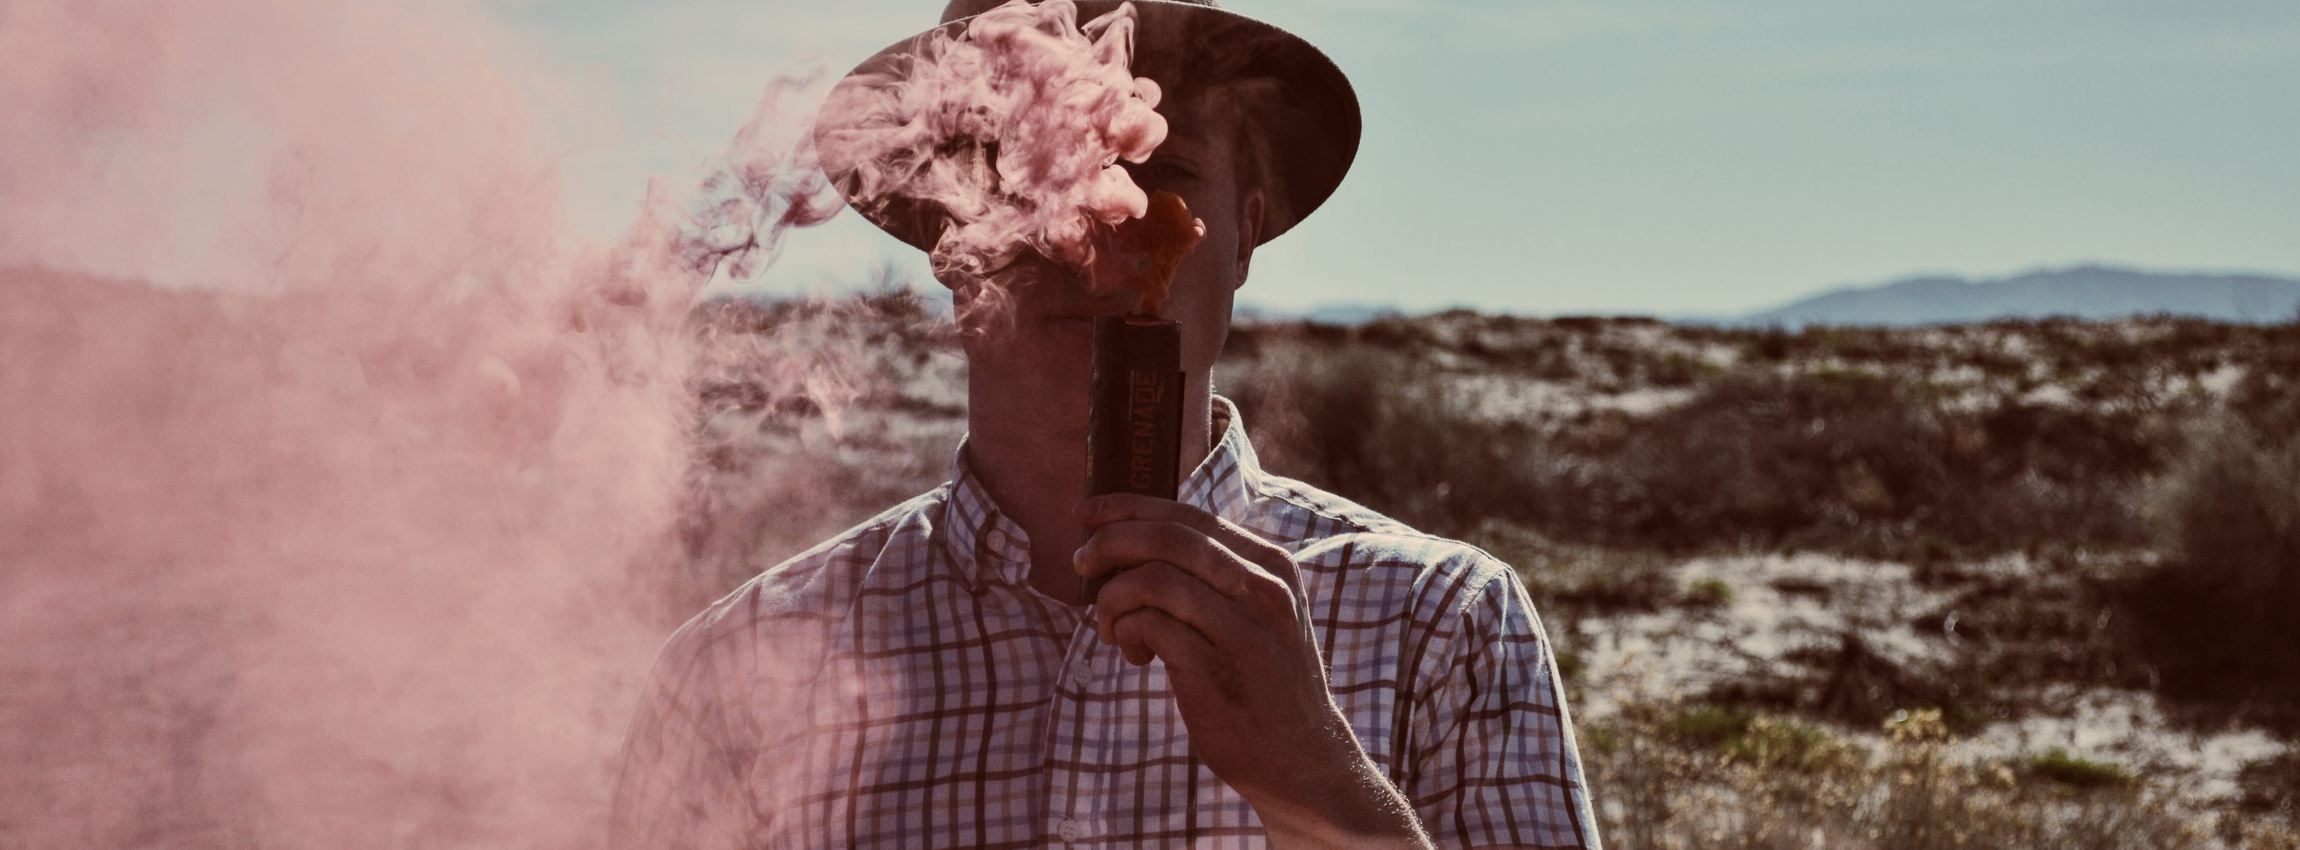



Home page
Post modes
Content editor
monetization

Slide 20

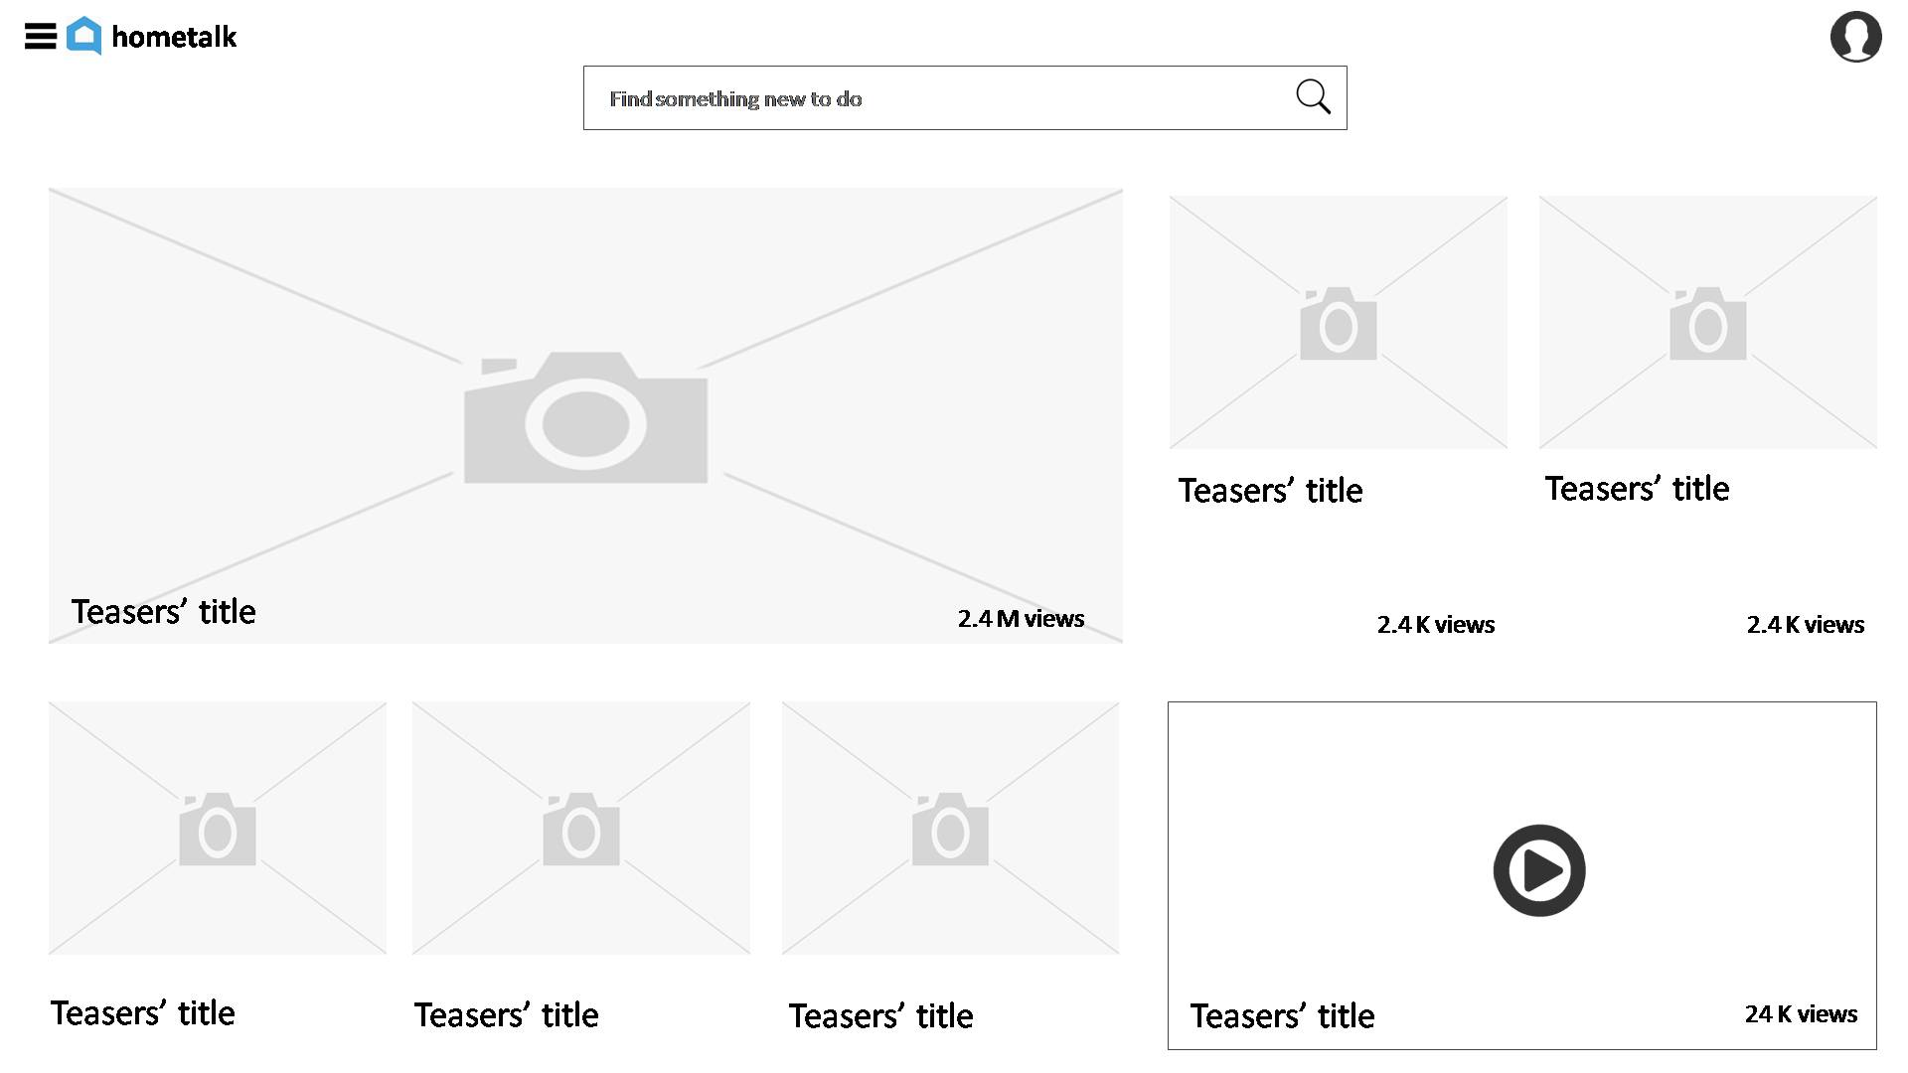
Home page
User product is in the center
Let the user product picture/video/slideshow do the work. Short headline (same length as mobile) and sum of views.
Teasers order
The first teaser is the last post, the last teaser is the first post. Teaser picture size will grow as the sum of views grow.
Click on video – play the video
When user click on a video the video starts to play. On the video there will be a Floating button. The button will transfer to the post page.
Post text, picture or video – everyone is equally important
Don’t break the home page to sections.
Advertisement – break the pattern
A combination of teasers & advertisement in not linear pattern

Slide 21





hometalk
Find something new to do
Teasers’ title
Teasers’ title
Teasers’ title
2.4 M views
2.4 K views
2.4 K views
Teasers’ title
Teasers’ title
Teasers’ title
Teasers’ title
24 K views

Slide 22

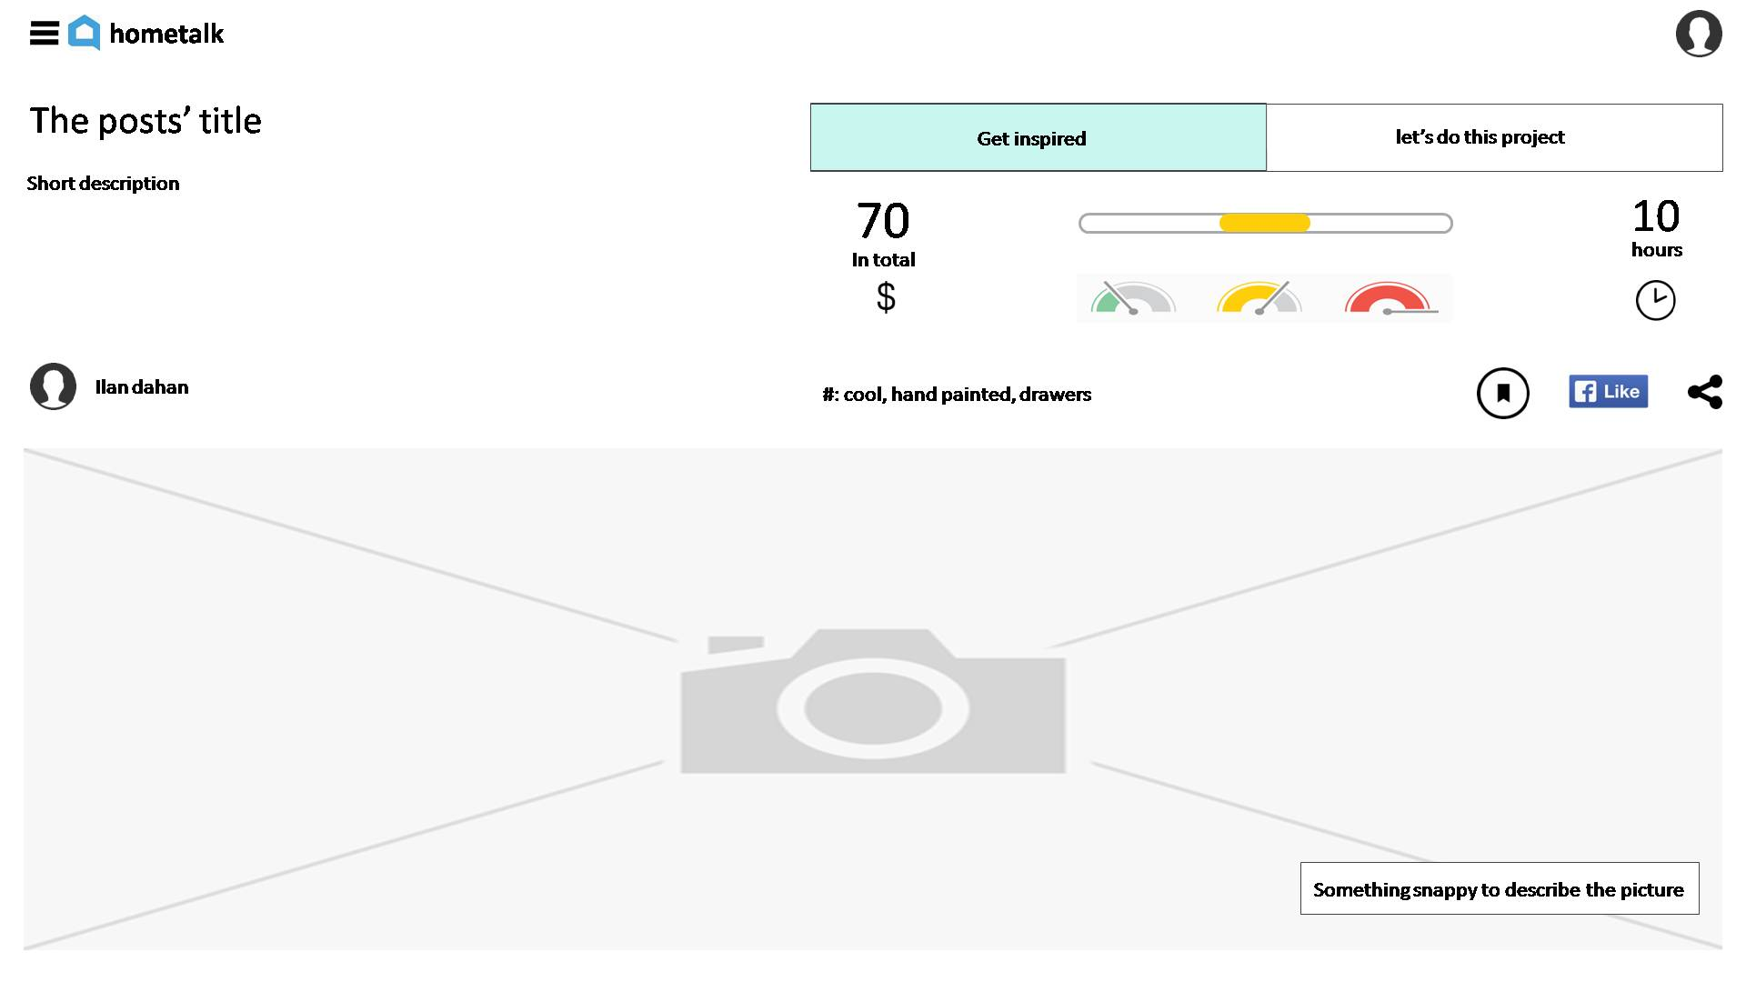
Post – get inspired mode
Get inspired mode will include:
Headline, short description, total project cost, time & difficulty, video/picture/ animated slideshow.
A new kind of post – wide shots of the product/process with text in between
The product will stand in the middle of attention

Slide 23







hometalk
The posts’ title
Get inspired
let’s do this project
Short description
70
10
In total
hours
Ilan dahan
#: cool, hand painted, drawers
Something snappy to describe the picture

Slide 24
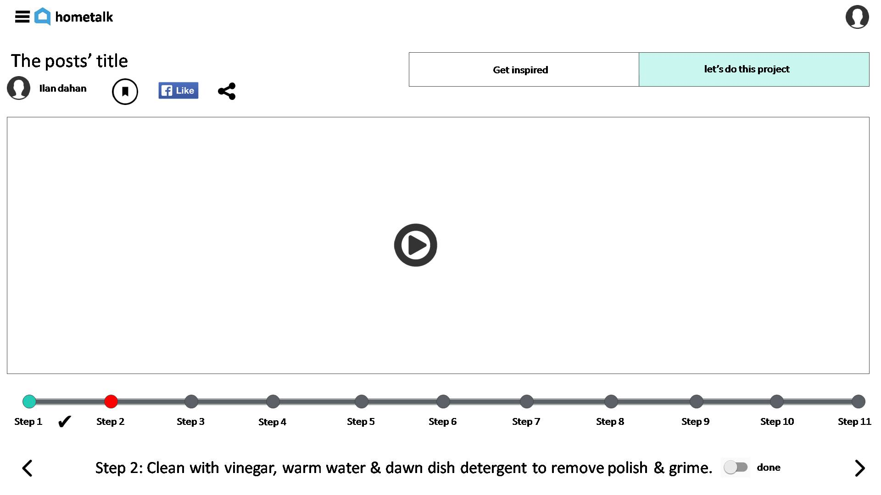
Post – let’s do this project mode
let’s do this project mode will include:
Headline, user name, share, save and like buttons, video/slideshow & the steps.
In the editor the user will have an option to enter video timestamp and the steps will play automatically with the video.
Only the user is able to mark step as done.

Slide 25



hometalk
The posts’ title
Get inspired
let’s do this project
Ilan dahan
Step 1
Step 2
Step 3
Step 4
Step 5
Step 6
Step 7
Step 8
Step 9
Step 10
Step 11
Step 2: Clean with vinegar, warm water & dawn dish detergent to remove polish & grime.
done

Slide 26
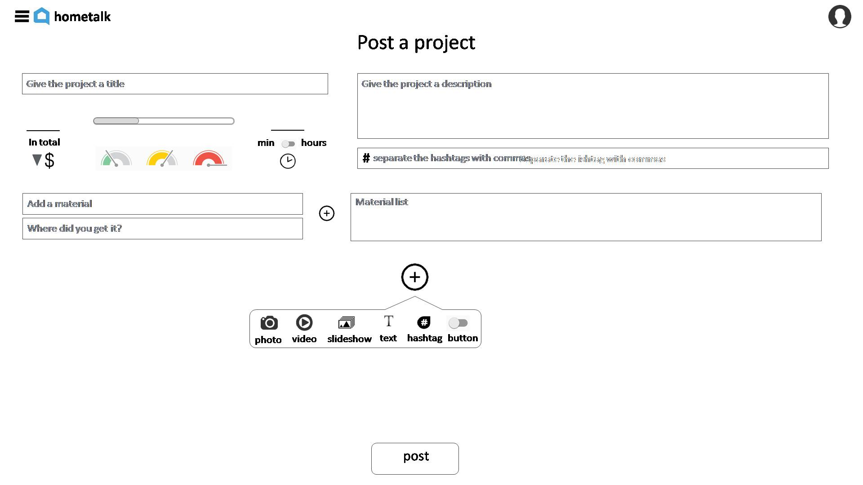
Content editor
More intuitive editor
Better UX to the users.

Slide 27









hometalk
Post a project
Give the project a title
Give the project a description
min
hours
#
Separate the ishtag with commas
separate the hashtags with commas
Add a material
Material list
Where did you get it?
photo
video
slideshow
text
hashtag
button
post

Slide 28

monetization
Reading
Back-end gamification based on points for user actions.
Each point will tell us what the user saw and how many times.
From the score we can give him the relevant posts on the suggest more sections, on the home page after login, relevant newspapers and efficient e-mail marketing.
Each post the user read the user get a point of the relevant topic for example: solar fountain will give the user score on - green living, solar, and garden
REVIEWS
Each review mark as visited and engaged post.
It means that the topic not only interested the user but also made the use do something
Notification & newspaper
With the sum of the points we know in which news to update the user and it will be relevant to him.
User/data partitions
All the users can be divided to partitions according to interest groups. With the data we can advertise more accurately and more efficiently.

Slide 29

Product & UX Business consultant (Freelance).
• Establish & launch products' growth road map via further products.
• Consultant product management aspects of the company including developing mobile platform, apps, social, content, and SEO strategies that boost traffic and online conversion.
• Defined UX strategy, shaped product's business needs (lean & full products), UI specs and provide direction to high performance team of UI developers to ensure best experience.
• Generated switch from B.I (business intelligence) to C.I (customer information) by analyze company's Big Data, defined customer partitions & executed a monetization up-sell campaigns accordingly.
Senior Product Manager at Keshet Broadcasting.
• Delivered detailed documentations (prd, mrd & UX briefs), mockups, wireframes, prototyping and supervised the implementation process across platforms (desktop, mobile Web & app).
• Planned a product’s lifecycle in collaboration with R&D, business development, marcom and management.
• Established and oversees knowledge management team that includes 3 system experts.
• Manage vendors, monitor their work, approve invoices etc.
Ilan dahan
Sr. Product manager & UX expert

